Slide 1

Manufacturer Performance Analysis Using Power BI
Strategic Dashboard for Sales and Market Share Insights

Slide 2
Problem Statements
1. VanArsdel Ltd. needed to better understand both internal sales performance and market positioning across regions.
2. There was a lack of visibility into year-over-year revenue growth and category-wise contribution.
3. Identifying underperforming countries and sales categories was difficult using traditional reports.
4. The company struggled to quickly interpret growth trends and market share shifts.

Slide 3
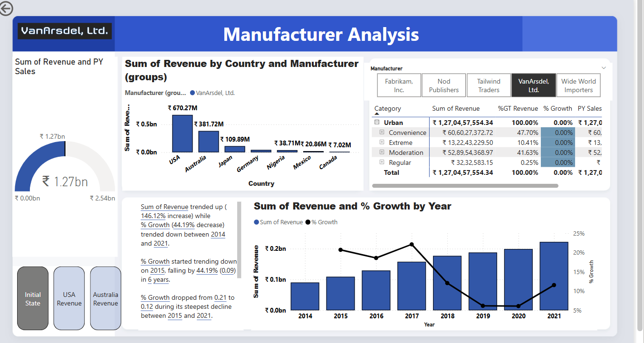
Dashboard

Slide 4
Power BI-Driven Manufacturer Analysis Dashboard
Built an interactive Power BI dashboard to analyze performance by country, year, and product category.
Implemented:
Revenue vs. PY Sales comparison
Growth analysis over time (2014–2021)
Geo-based segmentation for USA, Australia, Japan, and more
Category-wise revenue distribution for Convenience, Extreme, Moderation, and Regular products
Used:
Slicers for manufacturer filtering
Custom visuals (bar charts, donut charts, tables)
DAX functions to calculate % growth and revenue contribution

Slide 5
Strategic Solutions for Market and Sales Growth
Strengthen
Strengthen Regional Sales Intelligence
Use Power BI’s country-level performance data to identify regions with strong growth vs. underperformance.
Design region-specific marketing and distribution strategies based on historical sales trends and growth rates.
Diversify
Diversify Product Category Performance
Promote underperforming categories through tailored marketing campaigns and regional targeting.
Introduce category-specific offers, bundles, or limited-time deals to boost sales in lagging segments.
Enhance
Enhance Market Positioning
Benchmark internal sales data against competitor performance using available market share visuals.
Realign marketing investments to focus on markets and categories with competitive gaps or high potential.
Improve
Improve Forecasting and Strategic Planning
Use Power BI to track year-over-year growth and seasonality to forecast demand more accurately.
Apply predictive analytics features (e.g., forecasting, decomposition trees) for informed planning.
Enable
Enable Agile Decision-Making
Implement real-time dashboards for executive stakeholders (CMO, sales heads) to monitor KPIs on demand.
Empower cross-functional teams to access filtered, role-specific reports to accelerate responsiveness.

Slide 6
Conclusion
The Power BI dashboard revealed that while revenue grew by 146%, growth rates dropped by 44%, signaling the need for deeper category diversification and pricing revisions.
The USA and Australia are top-performing markets, while others like Mexico and Nigeria have untapped potential.
Using Power BI enabled interactive, real-time analysis that supports targeted product strategy, customer retention programs, and region-specific pricing models.
Moving forward, the integration of forecasting tools and external market benchmarks will further enhance decision-making.

Slide 7
Thank you

